Slide 1










Epigenetics assays
Analysis of gene expression regulation
Stéphanie Le Gras
GenomEast Platform, Illkirch, France

Slide 2
Epigenetics
Epigenetics is the study of changes in gene function that are mitotically and/or meiotically heritable and that do not entail a change in DNA sequence. (Wu et al, 2001)
Epigenetic mechanisms such as DNA methylation, Histone Post- Translational Modification (PTM), Nucleosome positioning are affected by development (in utero, childhood), environmental chemicals, drugs/pharmaceuticals, aging, diet,…
2

Slide 3
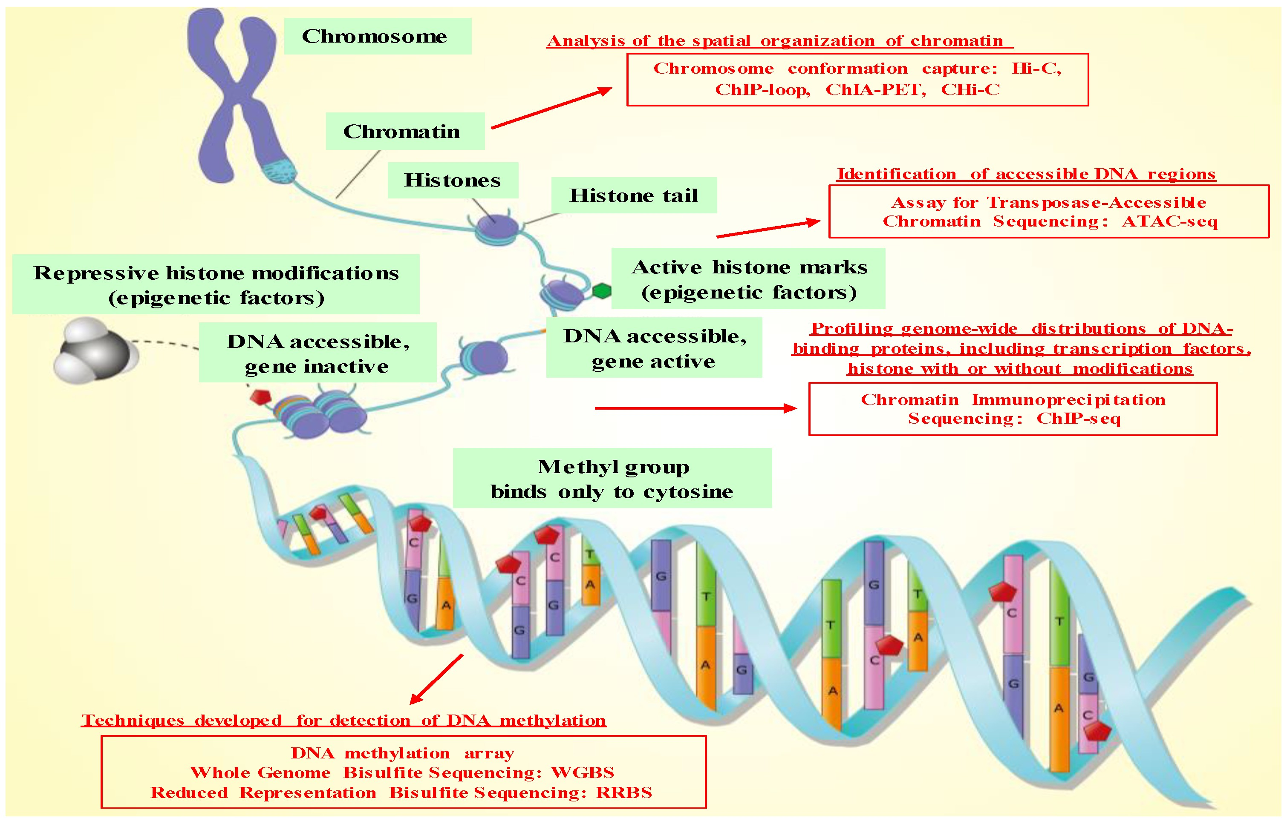
Technologies for epigenetics analysis
Hamamoto et al, 2020
3

Slide 4
ChIP-seq
Chromatin ImmunoPrecipitation followed by sequencing
4

Slide 5
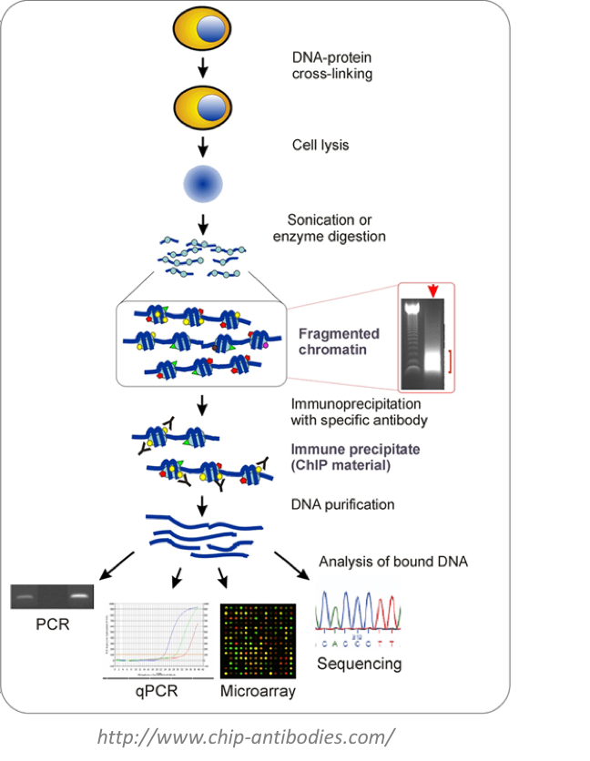
ChIP-seq
ChIP (=Chromatin Immuno-Precipitation)
differences in methods to detect the bound DNA
- small-scale: PCR / qPCR
- large-scale:
- microarray = ChIP-on-chip
- sequencing = ChIP-seq

Slide 6
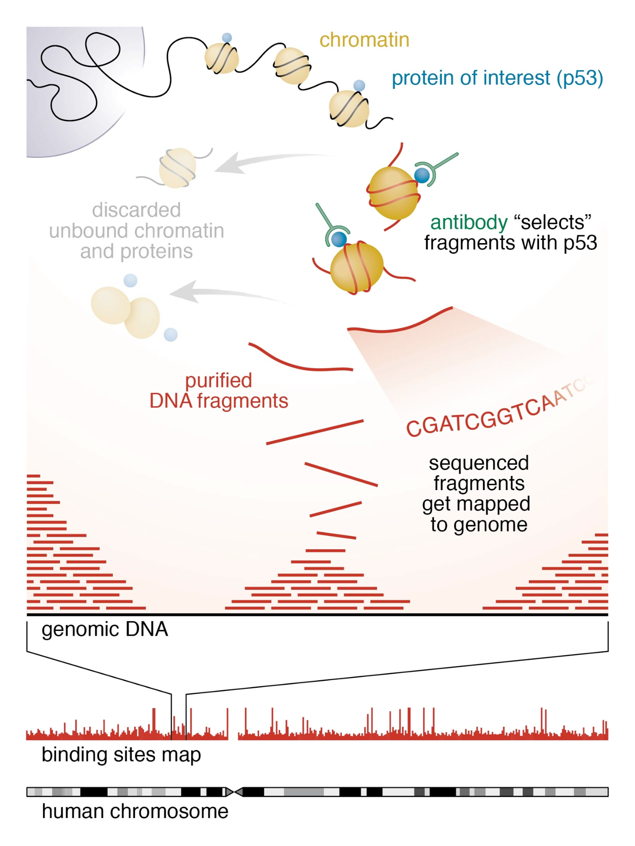
ChIP-seq
Johnson et al, 2007
Alternative to ChIP-on-chip (hybridization technique)
ChIP-seq combines chromatin
immunoprecipitation and sequencing to
analyze protein interactions with DNA
It can be used to detect and analyze
Binding sites of various proteins bound to DNA such as transcription factors (TF ChIP-seq)
Position of histone post translational
modifications (Histone ChIP-seq)
Nucleotide modification such methylation (MeDIP-seq)
Expected results of a ChIP-seq experiment are
genomic regions with significant sequenced
read enrichments (also called peaks)
https://hbctraining.github.io/Intro-to- ChIPseq/lessons/01_Intro_chipseq_data_organization.html
7

Slide 7





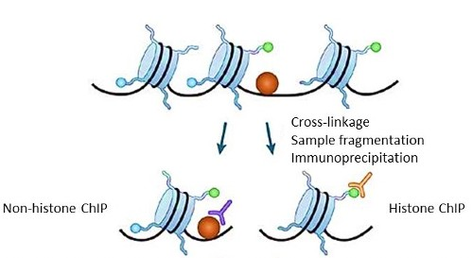
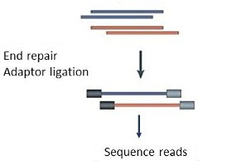
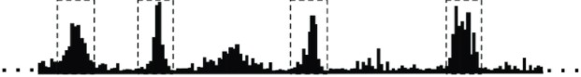
ChIP-seq process
Library prep and sequencing
ChIP
Data analysis
7

Slide 8

Chromatin ImmunoPrecipitation
Library prep and sequencing
ChIP
Data analysis
8

Slide 9
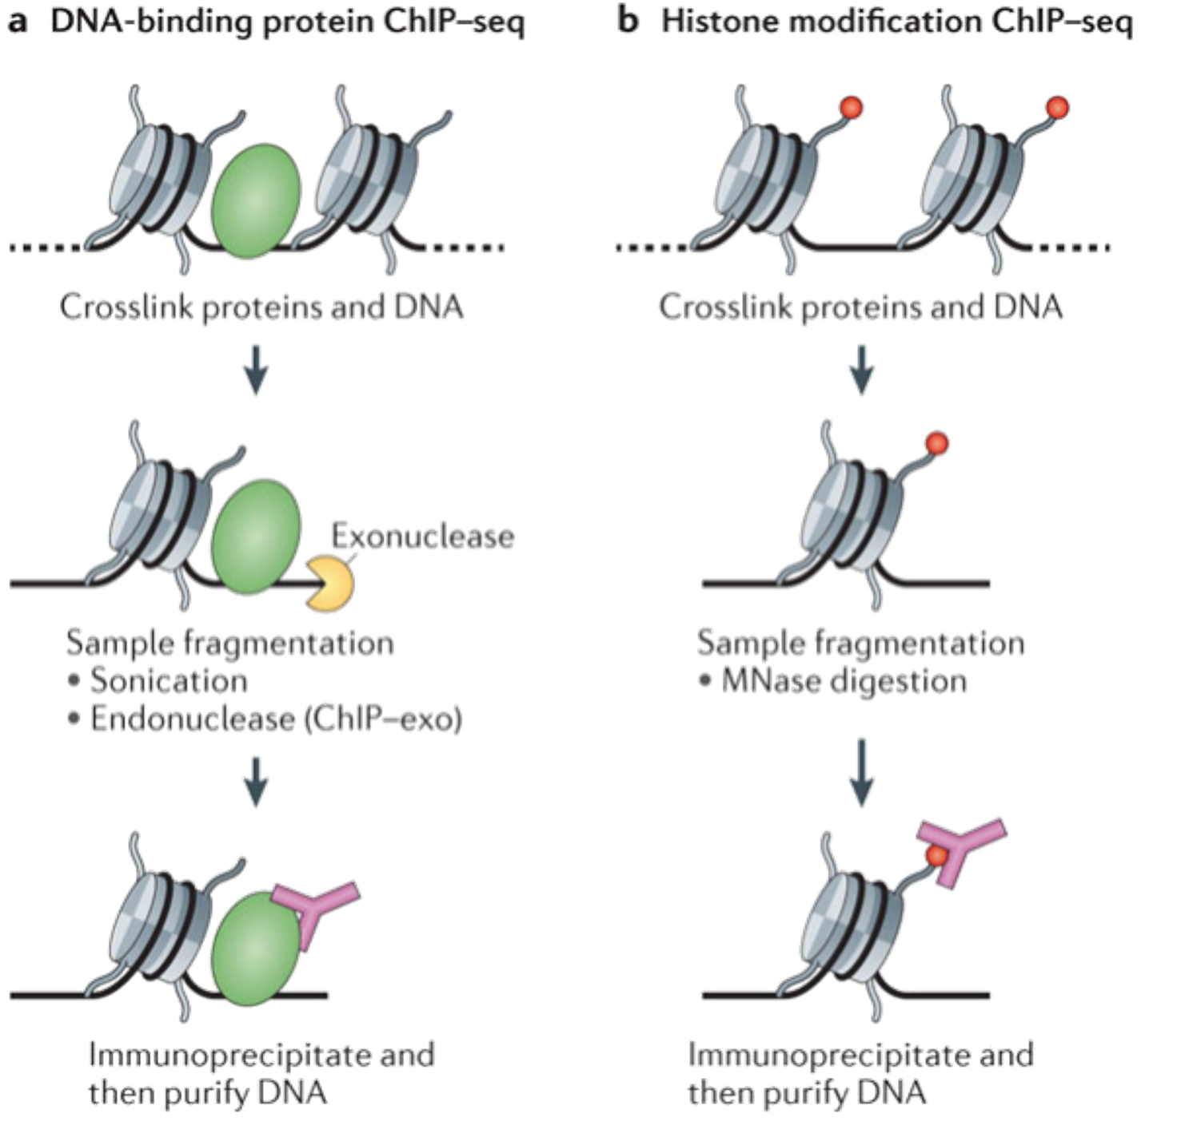
Chromatin ImmunoPrecipitation
ChIP is used to isolate DNA fragments bound by proteins or modified histones of interest using an antibody specifically design to target them
It requires a high number of cells (1- 10 million cells)
It requires highly tested and verified antibody working specifically for ChIP
Furey, 2012

Slide 10

Library prep and sequencing
Library prep and sequencing
ChIP
Data analysis

Slide 11
Experimental design

Slide 12

ENCODE
The Encyclopedia of DNA Elements (ENCODE) Consortium has carried out thousands of ChIP–seq experiments and has used this experience to develop a set of working standards and guidelines
Landt SG, Marinov GK, Kundaje A et al. (2012) ChIP-seq guidelines and practices of the ENCODE and modENCODE consortia. Genome research 22, 1813–1831.
See: https://www.encodeproject.org/about/experiment-guidelines/

Slide 13






Library prep
Starting material: ChIP sample (1-10ng of sheared DNA)
ChIP
Ligation of adapters
Size selection (200 or 600 bp) PCR amplification
Single-end Sequencing
Paired-end Sequencing

Slide 14
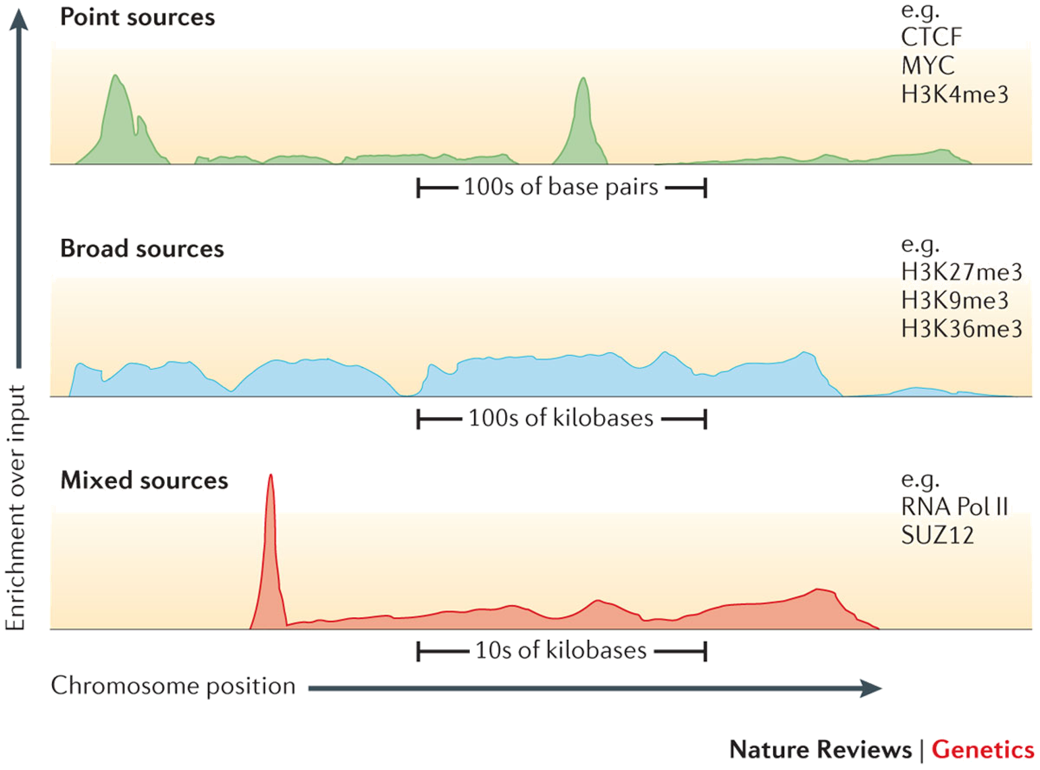
Sequencing
Paired-end or single-end
Short reads (50nt)
Number of reads needed depends on:
chipped protein,
type of expected profile,
number of expected binding sites,
size of the genome of interest.
Ex:
For human genomes, 20 million uniquely mapped read sequences are suggested for
point-source peaks, or 40 million for broad- source peaks.
For fly genome: 8 million reads
For worm genome: 10 million reads
Park, 2009

Slide 15
Controls
Used mostly to filter out false positives (high level of noise)
Idea: potential false positive will be enriched in both treatment and control.
A control will fail to filter out false positives if its enrichment profile is very different from the enrichment profile of false positive regions in the treatment sample
Most commonly used control: Input DNA (a portion of DNA sample removed prior to IP)
Choice of control is extremely important
It is recommended to cover the control in a higher extent than the IPs

Slide 16
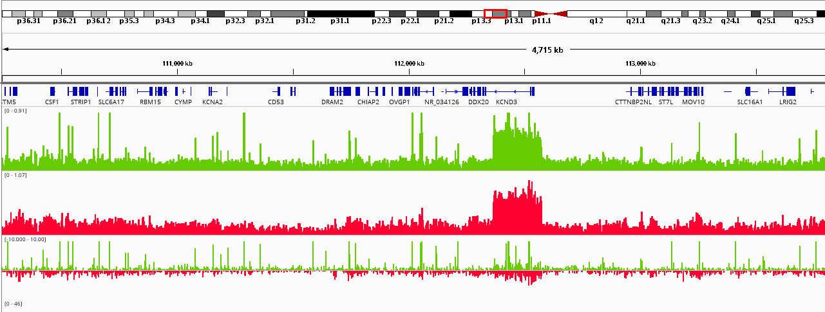
Why an Input is required ?
The input is used to model local noise level
Accessible regions are expected to produce more reads
Amplified regions (CNV) are expected to produce more reads
Closed
Open
Closed
Closed
Open
Closed
Closed
Open
Closed

Slide 17
Why an Input is required ?
The input is used to model local noise level
Accessible regions are expected to produce more reads
Amplified regions (CNV) are expected to produce more reads
Moreover, most peak callers are configured with an input as control
Closed
Open
Closed
Closed
Open
Closed
Closed
Open
Closed

Slide 18
Other controls
IgG (mock IP): controls for non-specific IP enrichment
Problem : low-complexity library (few reads)
Histone H3 (for H3 variants)
Uninduced condition (for inducible TFs)
Example : Glucocorticoid Réceptor
Induced by Dexamethasone (Dex)
Control vehicule = Ethanol (EthOH)
KO of your protein of interest
Non flagged cell lines
...

Slide 19
Replicates
A minimum of two replicates should be carried out per experiment.
Each replicate should be a biological rather than a technical replicate; that is, it results from an independent cell culture, embryo pool or tissue sample.

Slide 20
Data analysed in this course

Slide 21
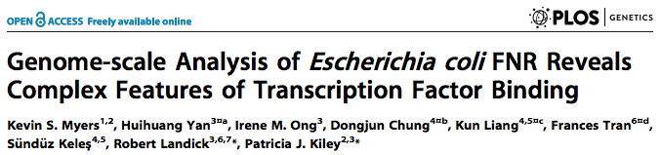

Dataset used
All experiments (GEO): GSE41187
Experiment: FNR IP ChIP-seq Anaerobic A (SRX189773 - SRR576933)
Control: anaerobic INPUT DNA (SRX189778 - SRR576938)

Slide 22
TIPS
Keep track of all command lines you run. You can for example, create a text file in which you write every commands you run.
Give content-explicit names to the files you’re generating.
Give to files the right extension.
Create directories with explicit names!!
Compress big files (with gzip for instance).
Notes:
Dense : à alléger ?

Slide 23






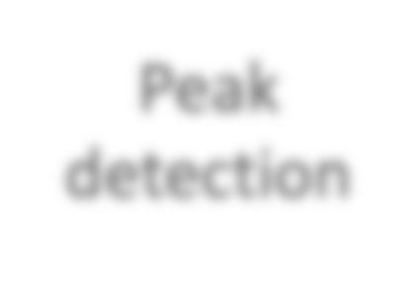
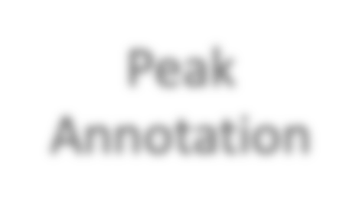






Analysis of ChIP-seq data
Advanced analysis
Motif Discovery
Differential analysis
Raw data
QC
Mapping
Peak detection
Peak Annotation
Meta profiles / Clustering
…

Slide 24
Analysis of ChIP-seq data
Advanced analysis
Motif Discovery
Differential analysis
Raw data
QC
Mapping
Peak detection
Peak Annotation
Meta profiles / Clustering
…

Slide 25
Analysis of chIP-seq data
Library prep and sequencing
ChIP
Data analysis

Slide 26
Raw Data (fastq)
Quality control
Downloading ChIP-seq reads from NCBI
Mapping (bam)
Filtering (bam)
Visualization
Quality Control
Peak calling (bed)
Annotation
Motif discovery

Slide 27
Connect to the server and set up your environment

Slide 28
Quality control of the reads

Slide 29
Quality control of the reads
As for any NGS datasets
FastQC program

Slide 30
Raw Data (fastq)
Quality control
Quality control of the reads and statistics
Mapping (bam)
Filtering (bam)
Visualization
Quality Control
Peak calling (bed)
Annotation
Motif discovery

Slide 31
Mapping

Slide 32
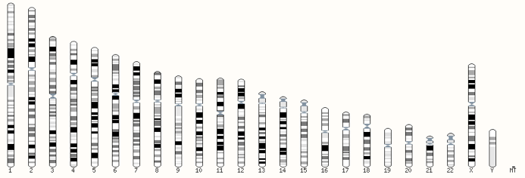
Mapping example
ATGCGATTA
?
?
?
Human chromosomes

Slide 33


Genomic coordinates
ATGCGATTA
alignment
1
125,326,318 start
GPS
125,326,358 end
Genomic coordinate of the mapped read :
chr5 125326318 125326358 +
181,538,259
chromosome 5

Slide 34
Mapping
Find out the position of the reads within the reference genome
Ref. Genome
Reads
One position in the genome
Many possible positions (Repeat regions, duplicate regions, pseudogenes…)

Slide 35
Mapping tool used: Bowtie
(c.f. Course “mapping” Denis Puthier Monday afternoon)
Designed to align reads if:
many of the reads have at least one good, valid alignment,
many of the reads are relatively high-quality
the number of alignments reported per read is small (close to 1)
Langmead B. et al, Genome Biology 2009
Langmead B (2010) Aligning short sequencing reads with Bowtie. Curr Protoc Bioinformatics Chapter 11: Unit 11 17

Slide 36
Duplicated genomic regions
?
3 possible alignments
Keep 1 position randomly
Keep all possible position
Keep none

Slide 37
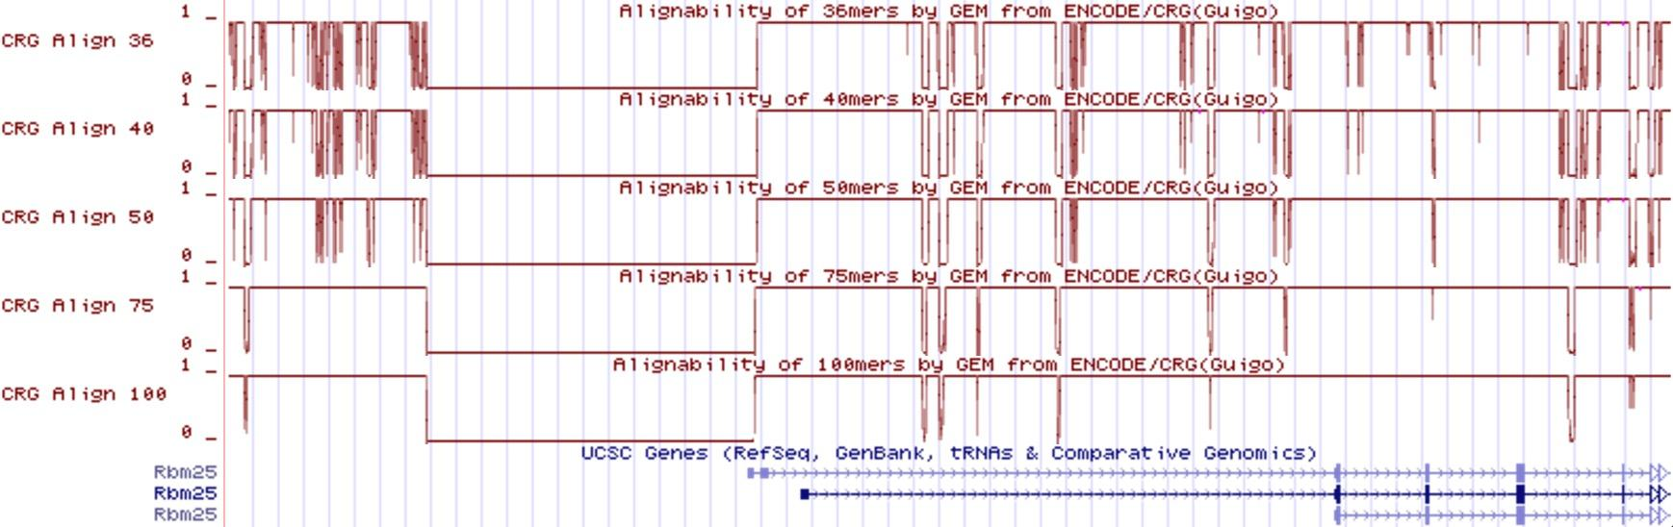
Mappability
Mappability (a): how many times a read of a given length can align at a given position in the genome
a=1 (read align once)
a=1/n (read align n times)

Slide 38
Raw Data (fastq)
Quality control
Mapping the reads with Bowtie
Mapping (bam)
Filtering (bam)
Visualization
Quality Control
Peak calling (bed)
Annotation
Motif discovery

Slide 39
Mapping: expected signal
For a transcription factor signal is expected to be sharp
The binding site itself is
generally not sequenced !
TF
TF
Sens alignments
TF
Rev/comp alignments
TF
TF

Slide 40
Mapping: the expected signal
For most histone marks the signal is expected to be broad
Asymmetry is less/not pronounced
Peak calling algorithms need to adapt to these various signals
H
H
H
H

Slide 41
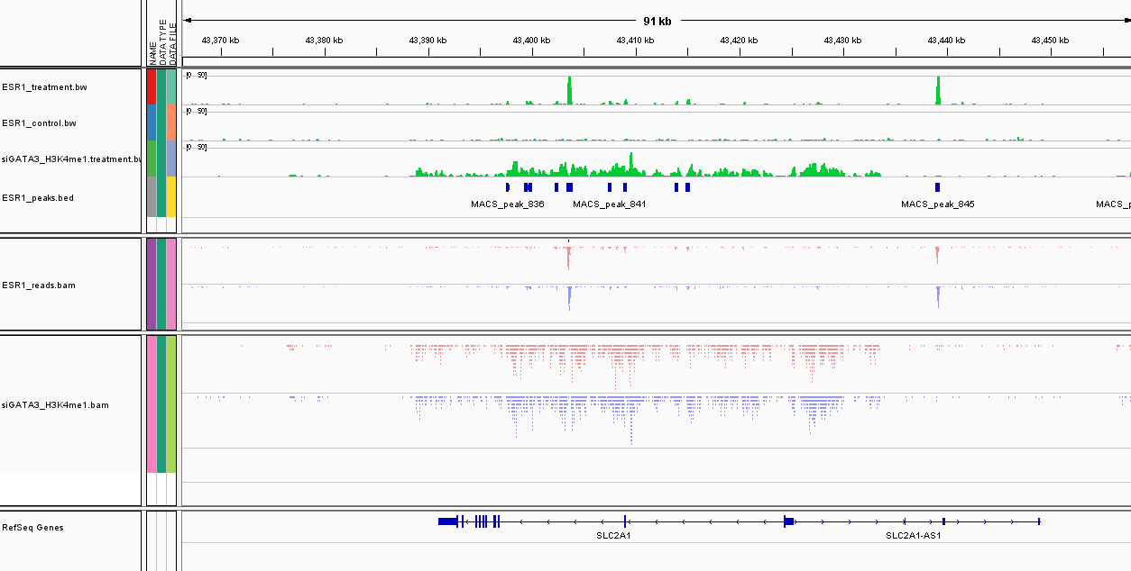
Mapping: observed signal
Trans. Factor
(ESR1)
Histone mark
(H3K4me1)

Slide 42
Filtering mapped reads

Slide 43
Which reads to filter ?
Low-quality read alignments
Tool : samtools
Multi-mapped reads (unless removed during the mapping step)
Tool : samtools
Duplicated reads (PCR duplicates)
Tool : Picard MarkDuplicates

Slide 44
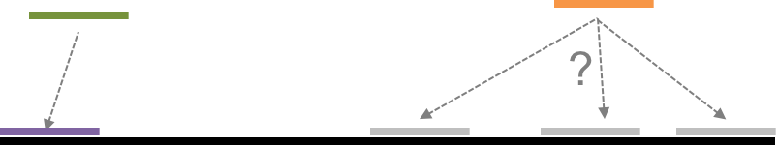
Source of confusion
uniquely mapped reads = reads that “matches” only 1 region in the genome
Uniquely mapped
multi-mapped
duplicated reads = reads that “match” at the SAME location (same start, strand)
“Stack” of duplicated reads

Slide 45
PCR duplicates
PCR duplicates
Related to poor library complexity
The same set of fragments are amplified, may indicates that immuno-precipitation failed
Tools to check for
FastQC report (duplicate diagram)
PCR bottleneck metric (ENCODE)

Slide 46
QC : PBC (PCR Bottleneck Coefficient)
An approximate measure of library complexity
PBC = N₁/N_{d}
N₁= Genomic position with 1 read aligned
N_{d} = Genomic position with ≧ 1 read aligned
Value :
0-0.5: severe bottlenecking
0.5-0.8: moderate bottlenecking
0.8-0.9: mild bottlenecking
0.9-1.0: no bottlenecking
❌
✅
https://genome.ucsc.edu/ENCODE/qualityMetrics.html
Notes:
Note that the most complex library, random DNA, would approach 1.0, thus the very highest values can indicate technical problems with libraries. It is the practice for some labs outside of ENCODE to remove redundant reads; after this has been done, the value for this metric is 1.0, and this metric is not meaningful. 82% of TF ChIP, 89% of His ChIP, 77% of DNase, 98% of FAIRE, and 97% of control ENCODE datasets have no or mild bottlenecking.

Slide 47
Raw Data (fastq)
Quality control
Estimating the number of duplicated reads
Mapping (bam)
Filtering (bam)
Visualization
Quality Control
Peak calling (bed)
Annotation
Motif discovery

Slide 48
Quality Control on mapped reads

Slide 49
Assessing ChIP quality
Guidelines from ENCODE
Various metrics
Check duplicate rate (see previous Filtering section)
Use a Lorenz Curve (implemented in Deeptools fingerprint)
Look at strand cross-correlation (implemented in SPP BioC package and phantompeakqualtools)
Fraction of reads in peaks (FRiP, as proposed by ENCODE), but requires to find peaks.

Slide 50

Lorenz curve
“Ideal” world
100%
Analyze income among workers by computing cumulative sum.
If uniform income distribution :
Straight line
Line of equality
Fraction of total income
Cumulative income of people from lowest
to highest income
100%

Slide 51


Lorenz curve
“Ideal” world
“Trumpized” world
100%
Analyze income among workers by computing cumulative sum.
If uniform income distribution :
Straight line
If they were trumpized
Lorenz curve
Line of equality
Fraction of total income
Lorenz curve
Cumulative income of people from lowest
to highest income
100%

Slide 52
Lorenz curve
“Ideal” world
(Bad ChIP)
“Trumpized” world
(Good ChIP)
100%
Analyze income among workers by computing cumulative sum.
If uniform income distribution :
Straight line
If they were trumpized
Lorenz curve
Here the workers are the genome windows and incomes are reads
Line of equality
Fraction of total reads
Lorenz curve
100%
Cumulative genome windows from lowest read counts to highest

Slide 53
Raw Data (fastq)
Quality control
Plot the Lorenz curve with Deeptools
Mapping (bam)
Filtering (bam)
Visualization
Quality Control
Peak calling (bed)
Annotation
Motif discovery

Slide 54
Strand cross-correlation
Compute strand cross correlation for each window w across the genome.
Use various distance d and compute the mean cross-correlation observed
Strand cross-correlation
for each window and various d values
r = 1
Mean cross-correlation
Coverage windows
d
2
4
6
4
2
0
0
2
4
6
4
2
0
0
0
100
d

Slide 55
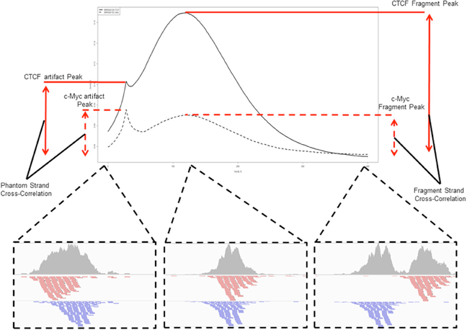

Notes:
This typically produces two peaks when cross-correlation is plotted against the shift value: a peak of enrichment corresponding to the predominant fragment length and a peak corresponding to the read length (“phantom” peak).

Slide 56
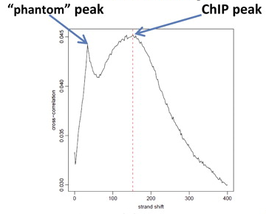
Strand cross-correlation
Notes:
This typically produces two peaks when cross-correlation is plotted against the shift value: a peak of enrichment corresponding to the predominant fragment length and a peak corresponding to the read length (“phantom” peak).

Slide 57
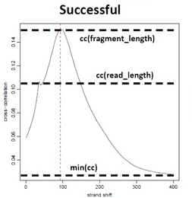
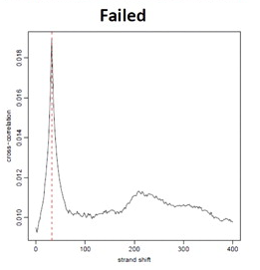
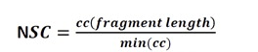
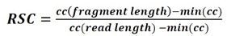
Strand cross-correlation
NSC: normalized strand coefficient
Relative strand correlation (RSC)
RSC ≥ 0.8 is recommended
NSC ≥ 1.05 is recommended

Slide 58
Visualization: computing a genomic coverage file

Slide 59
Raw Data (fastq)
Quality control
Visualizing the data in a genome browser
Mapping (bam)
Filtering (bam)
Visualization
Quality Control
Peak calling (bed)
Annotation
Motif discovery

Slide 60
Bam files are fat
BAM files are fat as they do contain exhaustive information about read alignments
Memory issues (can only visualize fraction of the BAM)
Need a more lightweight file format containing only genomic coverage information:
❌ Wig (not compressed, not indexed)
✅ TDF (compressed, indexed)
✅ BigWig (compressed, indexed)

Slide 61
Coverage file and read extension
BAM files do not contain fragment location but read location
We need to extend reads to compute fragments coordinates before coverage analysis
Not required for PE
Window
w_{i}
w_{i+1}
w_{i+2}
w_{i+3}
w_{i+4}
Coverage
6
15
20
14
5

Slide 62
Library size normalization
IP condition A
IP condition B
Inter-condition
normalization
IP vs input
normalization
IP vs input
normalization
input condition A
input condition B

Slide 63
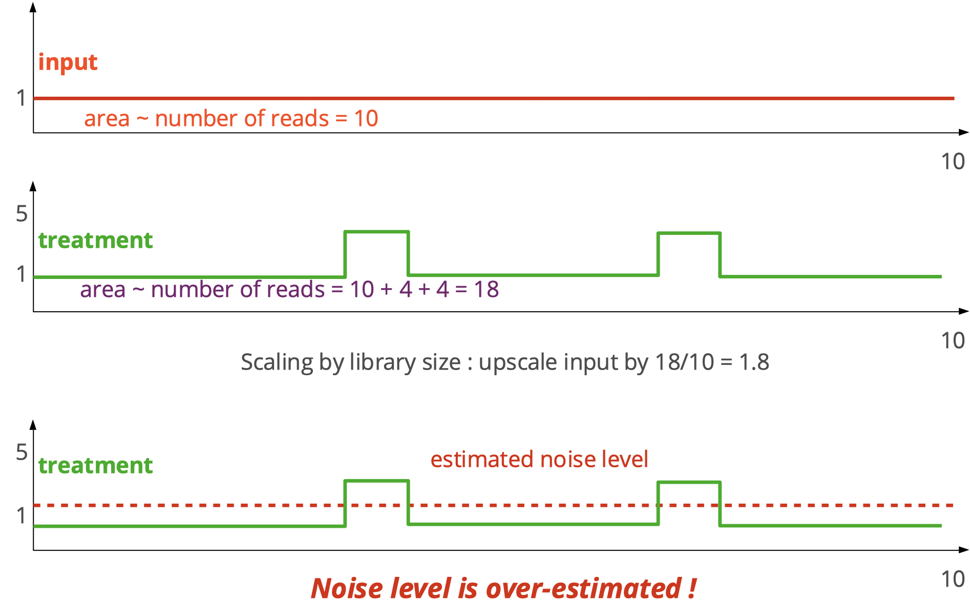
Library size normalization (input vs IP)

Slide 64
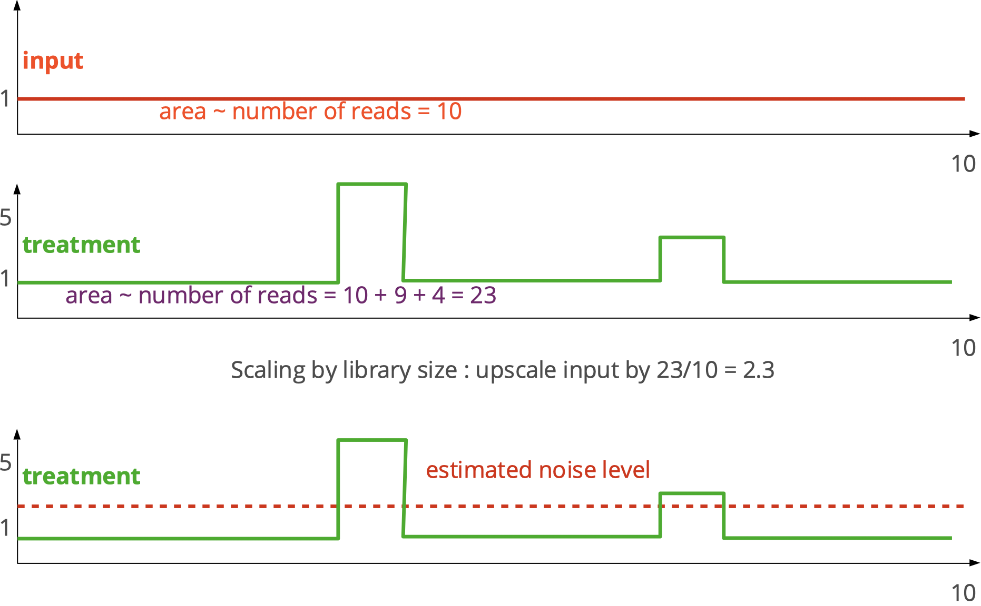
Library size normalization (input vs IP)

Slide 65
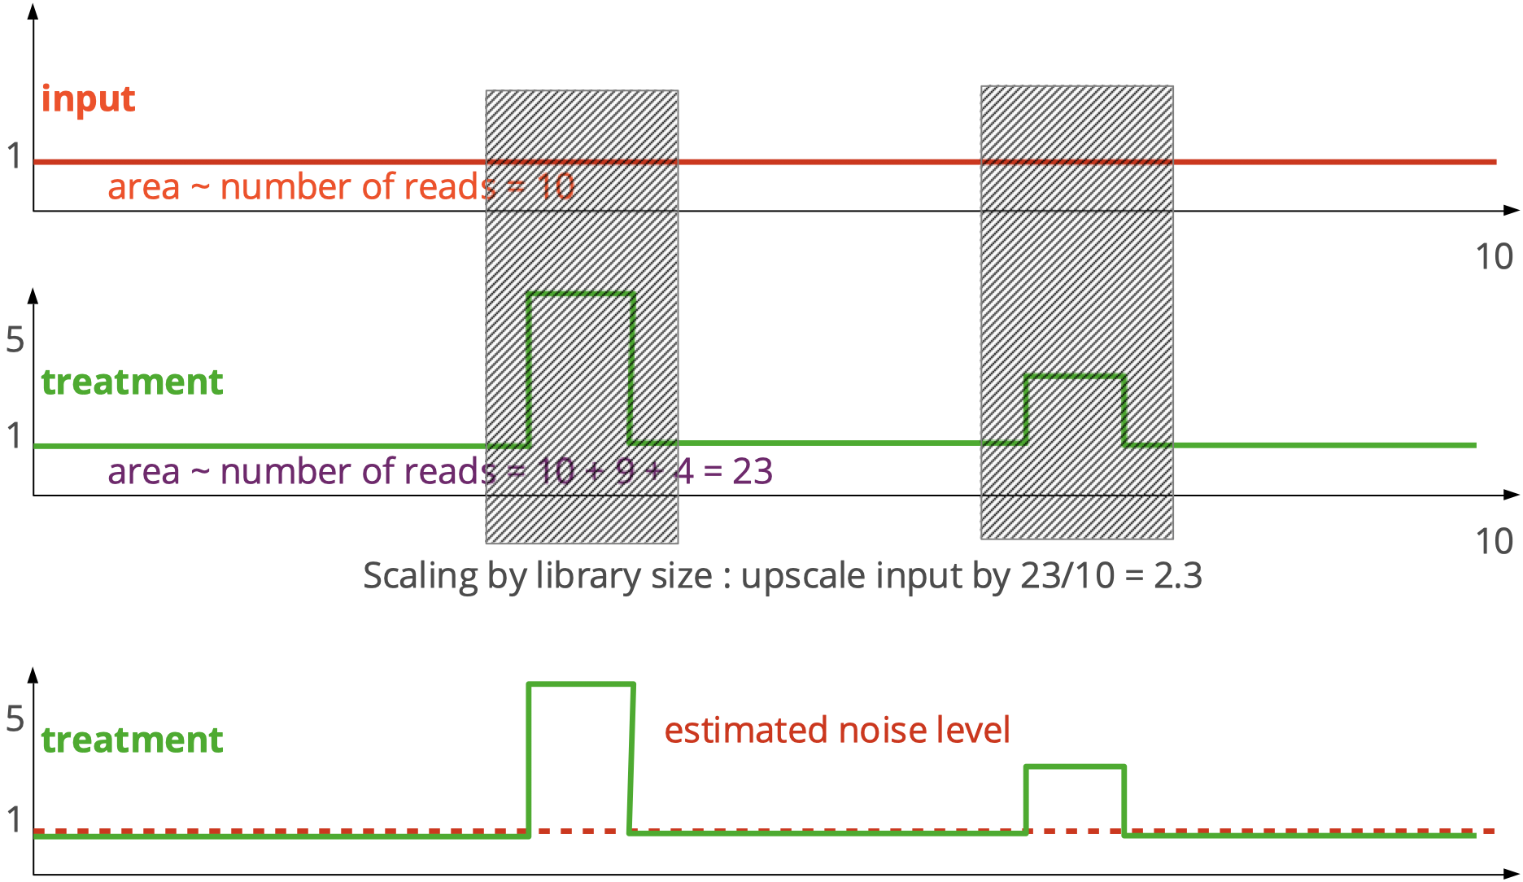
Library size normalization (input vs IP)

Slide 66
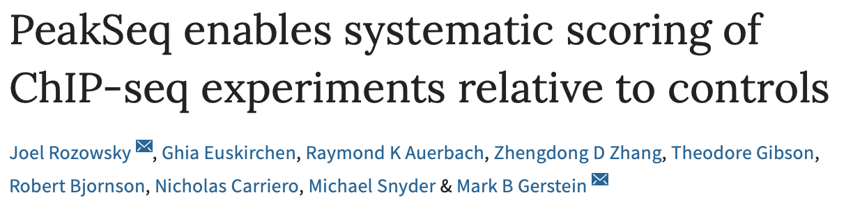
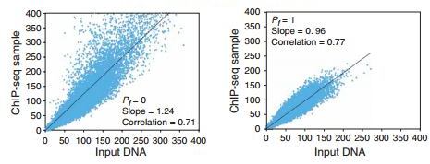
Library size normalization
Example of PeakSeq
All peaks
Signal peaks removed

Slide 67
Raw Data (fastq)
Quality control
Viewing scaled data
Mapping (bam)
Filtering (bam)
Visualization
Quality Control
Peak calling (bed)
Annotation
Motif discovery

Slide 68
Peak Calling

Slide 69
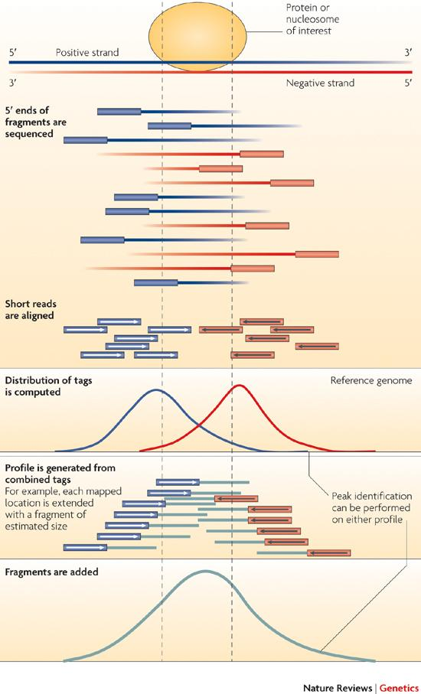
From reads to peaks
Chip-seq peaks are a mixture of two signals:
+ strand reads (Watson)
- strand reads (Cricks)
The sequence read density accumulates on forward and reverse strands centered around the binding site

Slide 70
From reads to peaks
Get the signal at the right position
Read shift
Extension
Estimate the fragment size
Do paired-end

Slide 71
Peak callers
The peak caller should be chosen based on
Experimental design
SE or PE (E.g MACS1.4 vs MACS2)
Expected signal
Sharp peaks (e.g. Transcription Factors).
E.g. MACS
Broad peaks (e.g. epigenetic marks).
E.g MACS, SICER,...
Sharp peaks
Broad peaks

Slide 72
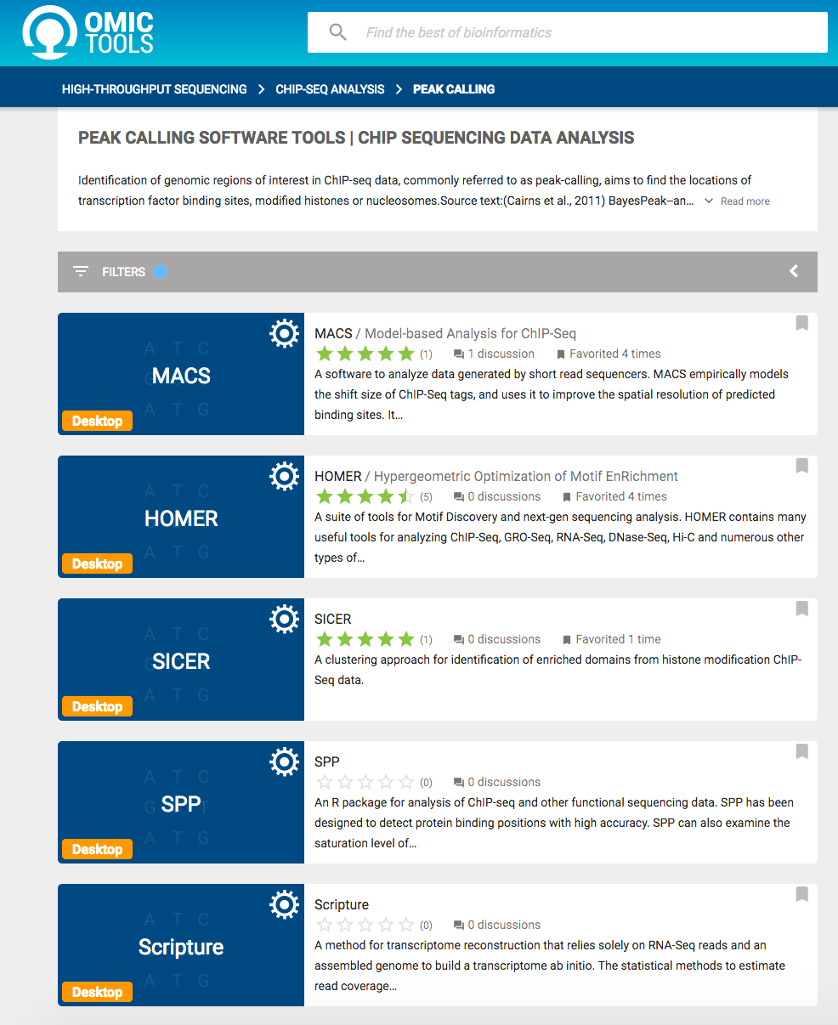
A variety of peak callers
60 programs listed on OMICTOOLS
Most support a control

Slide 73
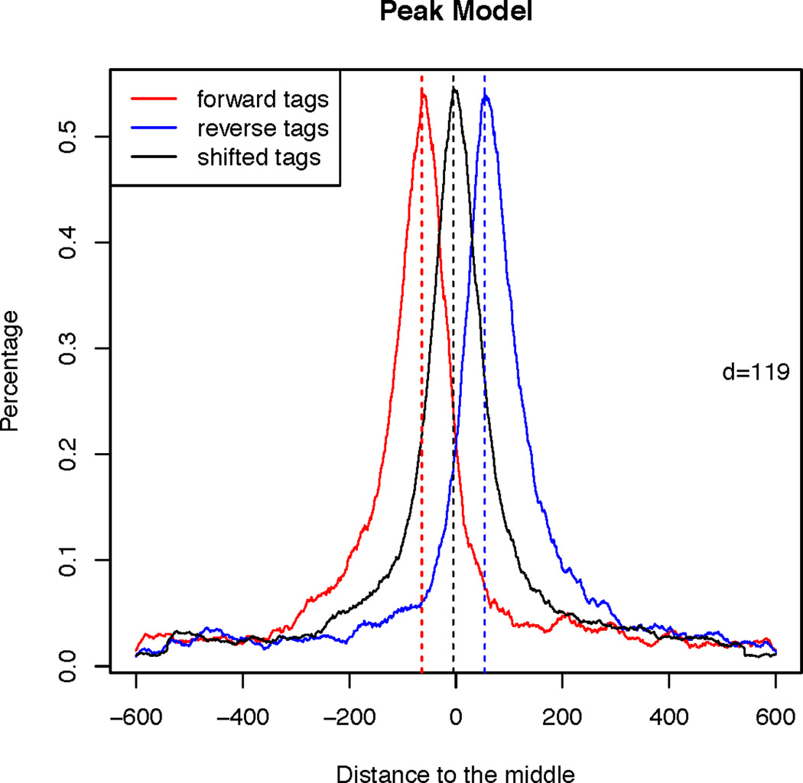
MACS [Zhang et al, 2008]
1. Modeling the shift size of ChIP-Seq tags
slides 2*bandwidth windows across the genome to find regions with tags more than mfold enriched relative to a random tag genome distribution
randomly samples 1,000 of these highly enriched regions
separates their + and - reads, and aligns them by the midpoint between their + and - read centers
define d as the distance in bp between the summit of the two distribution

Slide 74
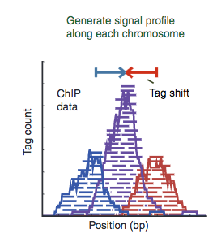
MACS [Zhang et al, 2008]
2. Peak detection
Scales the total Input read count to be the same as the total ChIP read count
Duplicate read removal
Reads are shifted by d/2
(d value is the model obtained
in step 1)
Pepke et al, 2009
Notes:
Λ_{local} is used to correct for local biais
λ_{1k}, λ_{5k} and λ_{10k} are λ estimated from the 1 kb, 5 kb or 10 kb window centered at the peak location in the control sample, or the ChIP-Seq sample when a control sample is not available (in which case λ_{1k} is not used)

Slide 75
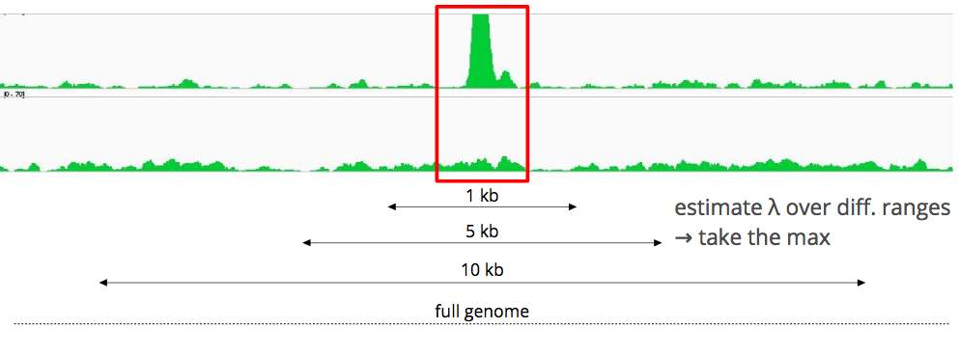
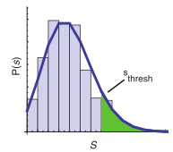
MACS [Zhang et al, 2008]
Slides 2d windows across the genome to find candidate peaks with a significant read enrichment (Poisson distribution p-value based on λ_{BG}, default 10⁻⁵)
Estimate parameter λ_{local} of Poisson distribution
Keep peaks significant under λ_{BG} and λ_{local} and with p-value < threshold

Slide 76
MACS [Zhang et al, 2008]
3. Multiple testing correction (FDR)
Swap treatment and input and call negative peaks
Take all the peaks (neg + pos) and sort them by increasing p-values
# Negative peaks with p-value < p
FDR = 2/27 = 0.074
FDR(p) =
# Selected peaks

Slide 77
MACS in summary
Step 1 : search for candidate regions that look like good peaks, to produce a fine-tuned model of the peaks (d value) to search in Step 2
Step 2 : actual peak calling
sIiding window length = 2*d
In each window : test if the region is a peak, by comparing the number of reads in the treatment and the expected number of reads
Comparison is based on a statistical test with a Poisson distribution, keeping only regions with p-value < threshold
Step 3 : correction for multiple testing (many windows were tested), calculation of FDR

Slide 78
Raw Data (fastq)
Quality control
Peak calling with MACS
(stop after step 5)
Mapping (bam)
Filtering (bam)
Visualization
Quality Control
Peak calling (bed)
Annotation
Motif discovery

Slide 79
How to deal with replicates

Slide 80

How to deal with replicates
Analyze samples separately and takes union or intersection of resulting peaks
Merge samples prior to the peak calling (e.g recommended by MACS) => “pooling”
Sample 1.a
Sample 1.b
Sample 1.a
Sample 1.b
Sample 1

Slide 81
IDR - Irreproducible Discovery Rate (ENCODE)
Measures consistency between replicates
Uses reproducibility in score rankings between peaks in each replicate to determine an optimal cutoff for significance.
Idea:
The most significant peaks are expected to have high consistency between replicates
The peaks with low significance are expected to have low consistency
https://sites.google.com/site/anshulkundaje/projects/idr

Slide 82
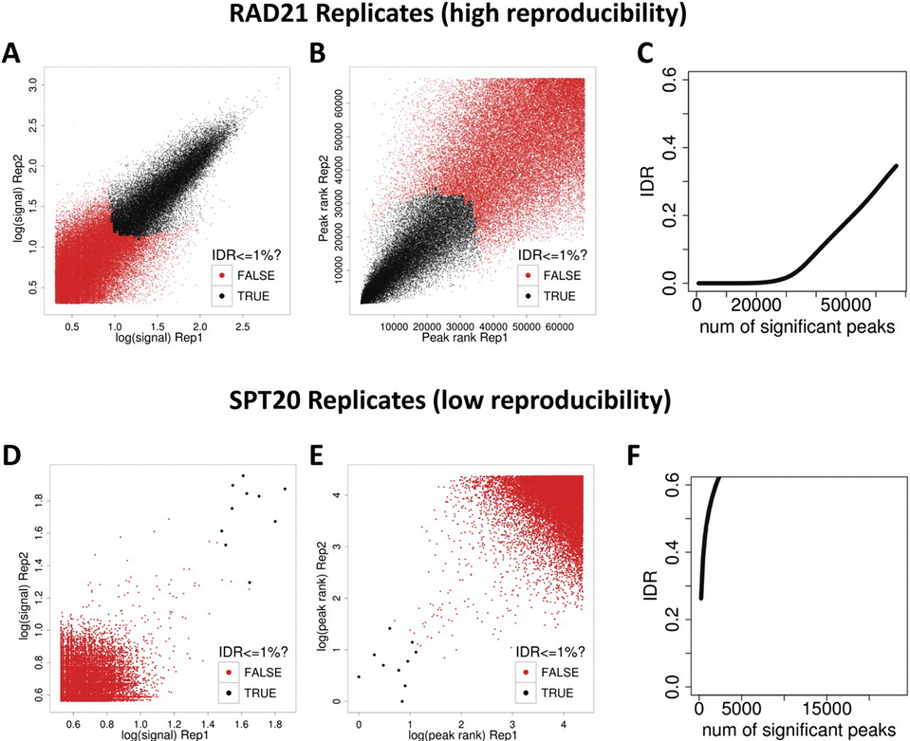
IDR
(!) IDR doesn’t work on broad source data!

Slide 83
Raw Data (fastq)
Quality control
Combine replicate (IDR)
Mapping (bam)
Filtering (bam)
Visualization
Quality Control
Peak calling (bed)
Annotation
Motif discovery

Slide 84
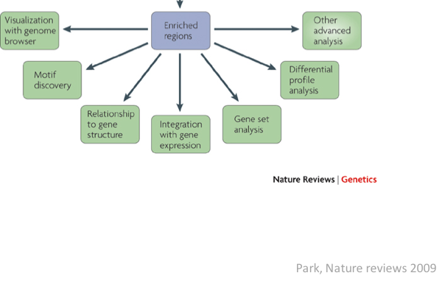
Processing steps are over !
Let’s do Biology !!!
peaks

Slide 85
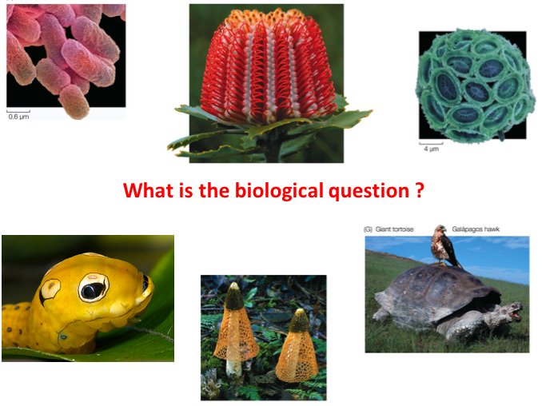

Slide 86

« see if you can find something in the data »

Slide 87
« see if you can find something in the data »

Slide 88
What is the biological question ?
Where do a transcription factor (TF) bind ?
How do a transcription factor (TF) bind ?
Which binding motif(s) (can be several for a given TF !!)
Is the binding direct to DNA or via protein-protein interactions ?
Are there cofactors (maybe affecting the motif !!), and if so, identify them
Which regulated genes are directly regulated by a given TF ?
Where are the promoters (PolII) and chromatin marks ?

Slide 89
Should drive all « downstream » analyses
Will take time
to « do it all » !!!

Slide 90

cell biology (eg: luciferase assay) ?
in vitro assays (eg: EMSA) ?
Proteomic (eg: mass spectrometry) ?
Transgenics ?
Will depend on
the organism
available infrastructure

Slide 91
De novo motif discovery

Slide 92
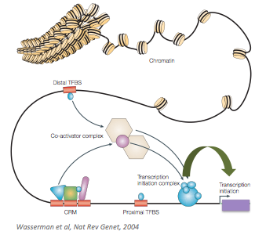
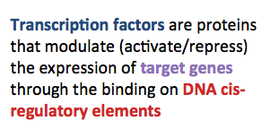
Biological concepts of transcriptional regulation

Slide 93
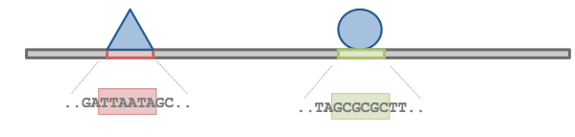
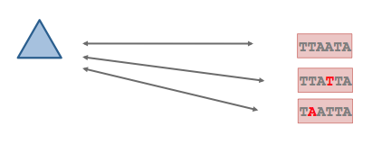
Transcription factor specificity
How do TF « know » where to bind DNA ?
TF recognize TFBS with specific DNA sequences
a given TF is able to bind DNA on TFBSs with different sequences

Slide 94
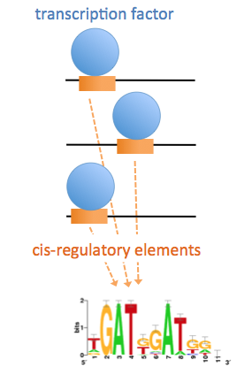

Binding specificity

Slide 95
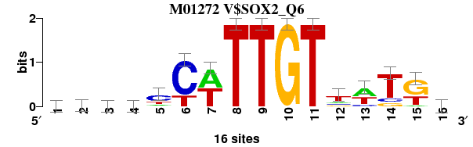
From binding sites to binding motif
Collection of binding sites used to build the Sox2 matrix (TRANSFAC M01272 )
R15133 GCCCTCATTGTTATGC
R15201 AAACTCTTTGTTTGGA
R15231 TTCACCATTGTTCTAG
R15267 GACTCTATTGTCTCTG
R16367 GATATCTTTGTTTCTT
R17099 TGCACCTTTGTTATGC
R19276 AATTCCATTGTTATGA
R19367 AAACTCTTTGTTTGGA
R19510 ATGGACATTGTAATGC
R22342 AGGCCTTTTGTCCTGG
R22344 TGTGCTTTTGTNNNNN
R22359 CTCAACTTTGTAATTT
R22961 GCAGCCATTGTGATGC
R23679 CACCCCTTTGTTATGC
R25928 TTTTCTATTGTTTTTA
R27428 AAAGGCATTGTGTTTC
Position-specific scoring matrix (PSSM)
A | 6 | 7 | 4 | 4 | 2 | 0 | 8 | 0 | 0 | 0 | 0 | 2 | 7 | 0 | 1 | 4
C | 2 | 2 | 6 | 5 | 9 | 12 | 0 | 0 | 0 | 0 | 0 | 2 | 2 | 2 | 0 | 6
G | 4 | 3 | 2 | 4 | 1 | 0 | 0 | 0 | 0 | 16 | 0 | 2 | 0 | 2 | 9 | 3
T | 4 | 4 | 4 | 3 | 4 | 4 | 8 | 16 | 16 | 0 | 16 | 9 | 6 | 11 | 5 | 2
Sequence logo

Slide 96
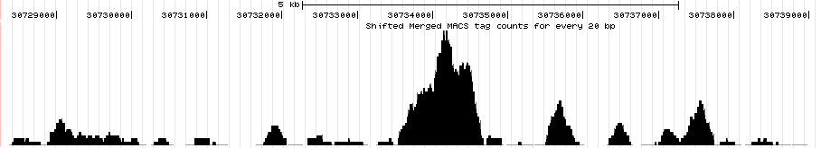
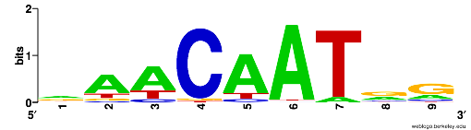
ChIP-seq peaks
>mm9_chr1_39249116_39251316_+
gagaggaagggggagaaagagggagggggagGGTGATAGGTAGCCAGGAG
CCAATGGGGGCGTTTTCCTTGTCCAGGCCACTTGCTGGAATGTGAGATGT
AGAATGACCCAAAGAGAGCTGCCAAGACAGAGCTCTGCCCCAGGAATTGA
ACTCAAAGGGTGTCAGAAAGCAGGTGGCCTTTGTGCACCTGGCGCGGGGA
CGTGGCTCCCCTCTTCCGGCTGGTCTAGCCAGGtgcctgcctgcctgcct
gccGTGATCTCTGGACGCCAGTAGAGGGTTGTTGTGGGTTTGGGTGAAAC
ACGCCACCCCTGAGCTCTTCCGCGGGGCTAGCAATCTCCCCATCACCCCA
TTCGCGCTCAGAACCCCCTCAGCGAGTCTAACAGCAGGCCTGGTTCCCCG
DNA sequence
A [24 54 59 0 65 71 4 24 9 ]
C [ 7 6 4 72 4 2 0 6 9 ]
G [31 7 0 2 0 1 1 38 55 ]
T [14 9 13 2 7 2 71 8 3 ]
Discovered motif
Motif logo

Slide 97
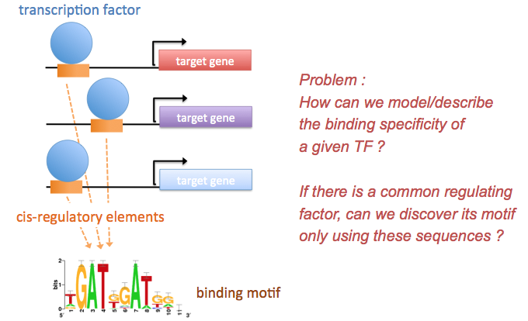
De novo motif discovery

Slide 98
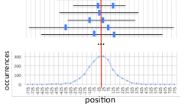
De novo motif discovery
Find exceptional motifs based on the sequence only
(No prior knowledge of the motif to look for)
Criteria of exceptionality:
Over-/under-representation: higher/lower frequency than expected by chance
Position bias: concentration at specific positions relative to some reference coordinates (e.g. TSS, peak center, …).

Slide 99
Some motif discovery tools
MEME (Bailey et al., 1994)
RSAT oligo-analysis (van Helden et al., 1998)
AlignACE (Roth et al. 1998)
RSAT position-analysis (van Helden et al., 2000)
Weeder (Pavesi et al. 2001)
MotifSampler (Thijs et al., 2001)
… many others

Slide 100
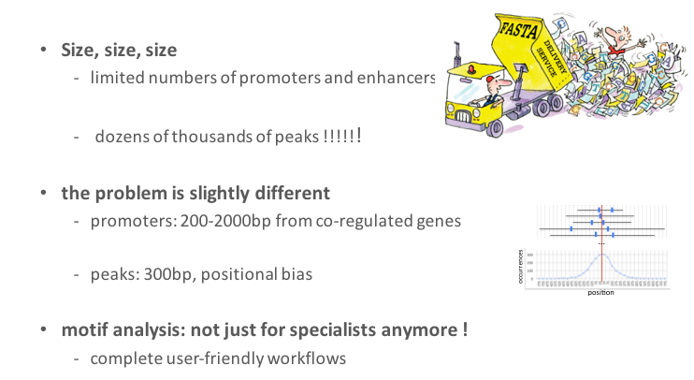
New approaches for ChIP-seq datasets

Slide 101
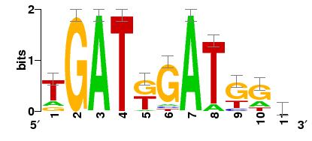
De novo motif discovery
Case 1: promoters of co-expressed genes
Case 2: ChIP-seq peaks
cis-regulatory
elements
TF binding site
target gene
target gene
target gene
binding motif (represented as a sequence logo)

Slide 102
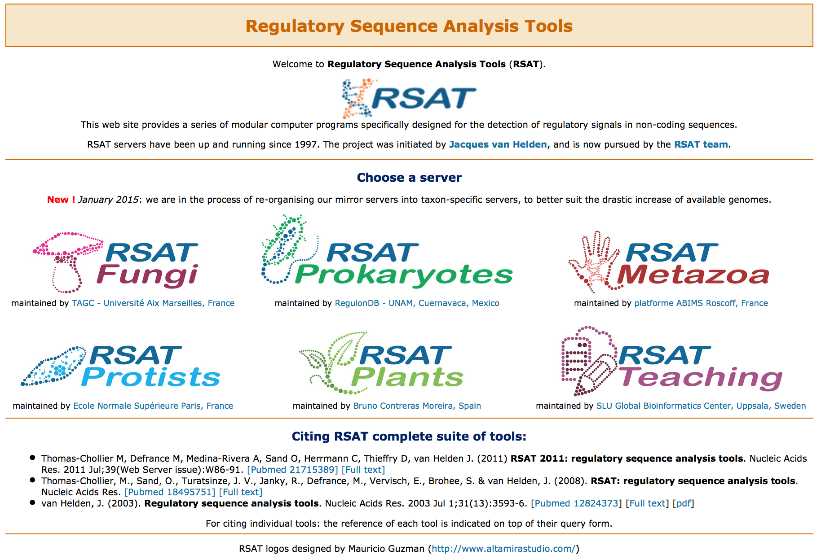
Regulatory sequence Analysis Tools (rsat.eu)
243 Fungi
9638 Bacteria + Archaea
92 Metazoa
186 Protists
39 Plants

Slide 103
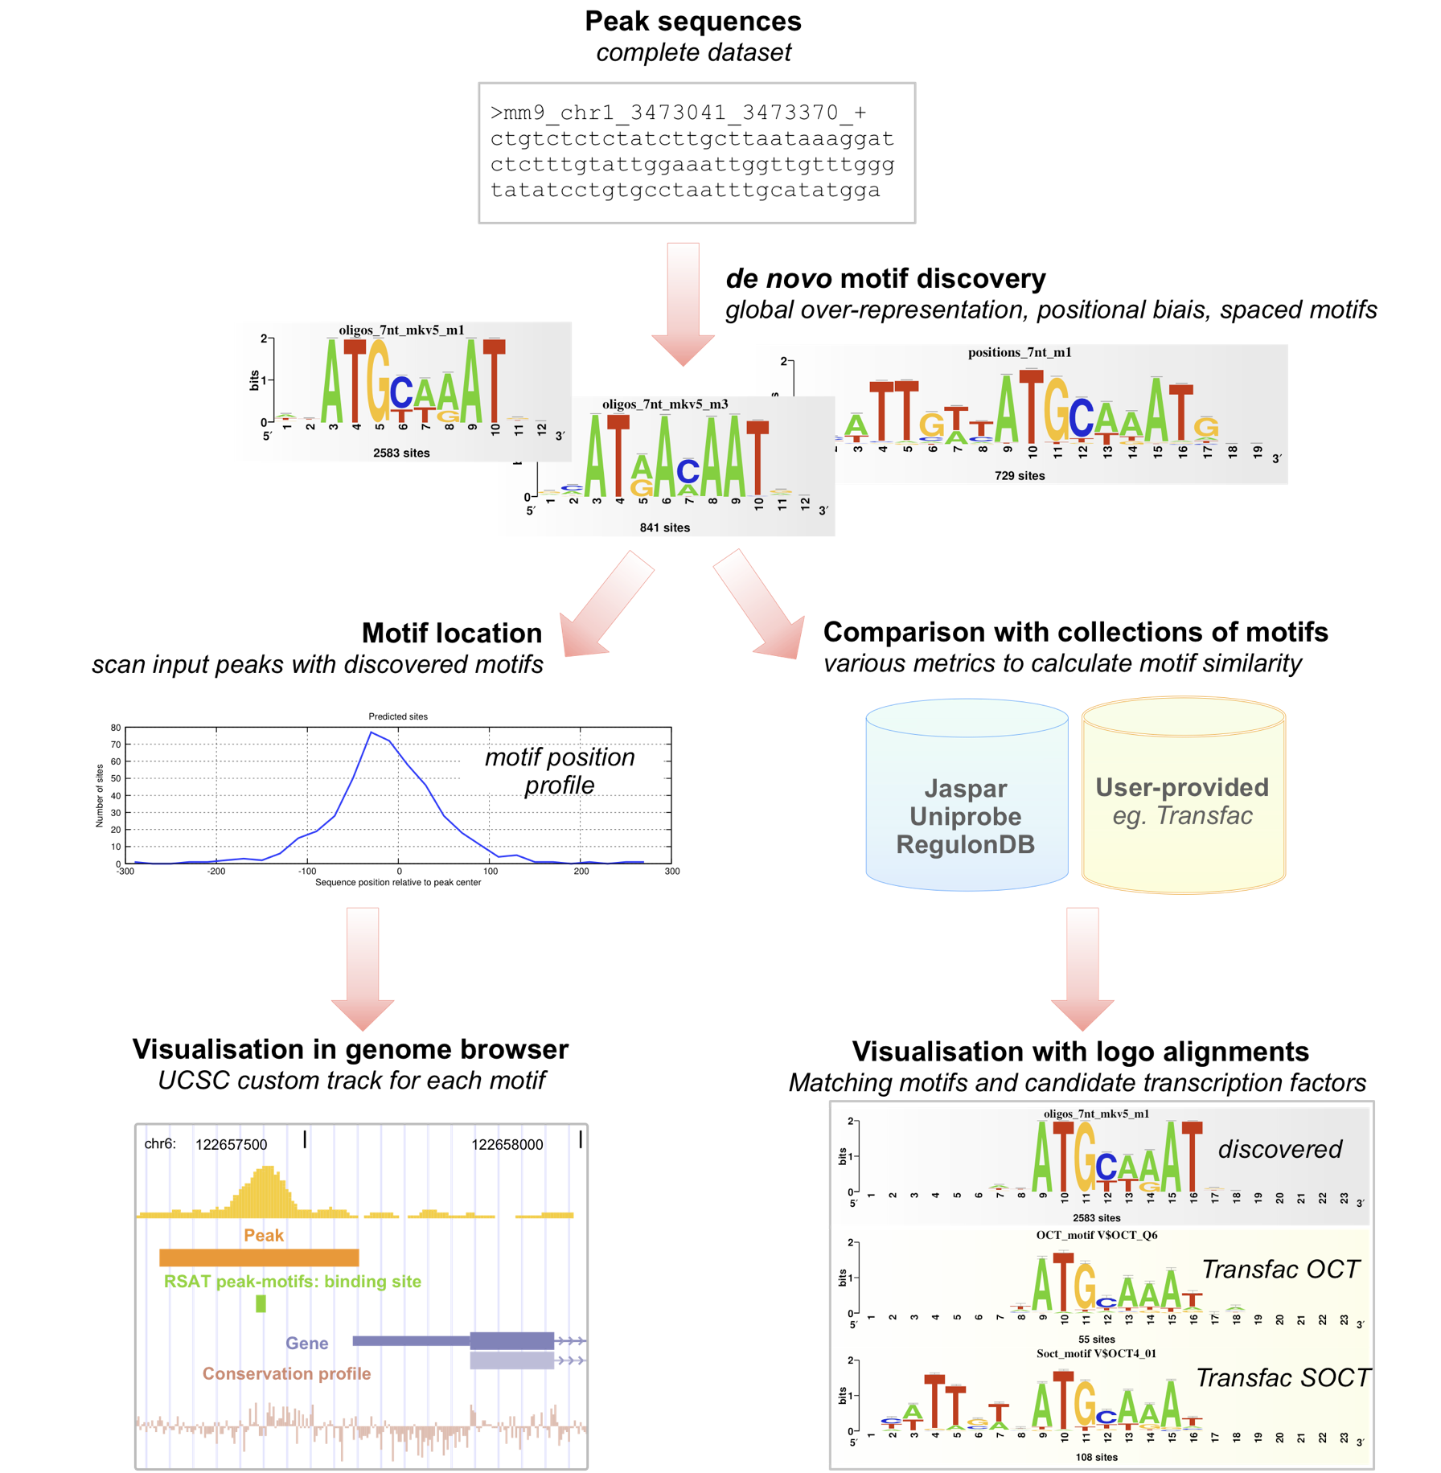
Peak-motifs
•fast and scalable
•treat full-size datasets
•complete pipeline
•web interface
•accessible to non-specialists

Slide 104

Peak-motifs: why providing yet another tool?
fast and scalable
treat full-size datasets
using 4 complementary algorithms
Global over-representation
oligo-analysis
dyad-analysis (spaced motifs)
Positional bias
position-analysis
local-words
1h
size limit of other websites
typical ChIP-seq dataset
Thomas-Chollier, Herrmann, Defrance, Sand, Thieffry, van Helden Nucleic Acids Research, 2012

Slide 105

RSAT menu
1. Get sequences
2. Run the analysis
3. Visualization
Help: tutorials,

Slide 106

RSAT Web forms
Tool name
Tool description
Tool parameters
Output
Go button (launches the analysis)
Demo button (fill in the form for test purposes)
Help

Slide 107
Raw Data (fastq)
Quality control
Motif analysis
Mapping (bam)
Filtering (bam)
Visualization
Quality Control
Peak calling (bed)
Annotation
Motif discovery

Slide 108

Motif discovery: frequency

Slide 109

Motif discovery: positional bias

Slide 110
Direct versus indirect binding
ChIP-seq does not necessarily reveal direct binding: The motif of the targeted TF is not always found in peaks!
Direct binding
Indirect binding

Slide 111
Peak annotation

Slide 112


Are peaks biased towards any genomic features?
How are the peaks distributed on the chromosomes?
Are there genomic features (promoters, intergenic, intronic, exonic regions) enriched in the peaks?
How are the peaks distributed compared to gene structures (TSS, TTS, introns, exons)?
How are they distributed compared to the genes?

Slide 113
Various tools available
ChIPseeker (Bioconductor) https://goo.gl/BemEsw
bedtools annotate : http://bedtools.readthedocs.io
HOMER annotatePeaks.pl
Warning : rely on the organism annotation and assembly version
=> not all organisms supported by all programs !

Slide 114

Which are the closest genes?
HOMER is a well-maintained suite of tools for functional genomics sequencing data sets. It can perform peak-calling and motif analysis, but we will use it for annotation of the peaks only.

Slide 115


Peak annotation
Goal: assigning a peak to one or many genome features (genes/transcripts) to understand which genes are possibly regulated by the protein of interest binding
The name of the gene is important as well as the genic region where the peak is located
Example of Homer tools:
Determines the distance to the nearest Transcription Start Site (TSS) and assigns the peak to that gene
Determines the genomic annotation of the region occupied by the center of the peak/region. Possible genomic annotation:
5’ UTR
Intron
Coding exon
3’ UTR
TSS (Transcription start site)
TTS (transcription termination site)
27

Slide 116

What are the genes associated to the peaks ?
Are there some functional categories over-represented ?
ChIP-seq peaks
Genes
Ontology terms
GO Molecular Function
GO Biological Process
Disease Ontology
Pathways
…

Slide 117
Various tools available
These tools work with gene lists
GSEA: http://www.broadinstitute.org/gsea
gProfiler: http://biit.cs.ut.ee/gprofiler/gost
GSAn: https://gsan.labri.fr/
HOMER: http://homer.salk.edu/homer
DAVID: http://david.abcc.ncifcrf.gov
These tools work with regions (BED files)
EnrichR: http://amp.pharm.mssm.edu/Enrichr/enrich
LOLA (Bioconductor) https://goo.gl/pWDZEs
GREAT: http://great.stanford.edu/public/html/

Slide 118
Raw Data (fastq)
Quality control
Associate peaks to closest genes
Mapping (bam)
Filtering (bam)
Visualization
Quality Control
Peak calling (bed)
Annotation
Motif discovery

Slide 119
Now that we have the genes,
Are there some functional categories over-represented ?
ChIP-seq peaks
Genes
Ontology terms
GO Molecular Function
GO Biological Process
Disease Ontology
Pathways
…

Slide 120


HOMER [Heinz et al., Mol Cell 2010]
Gene Ontology Analysis of Associated Genes: annotatePeaks go option
Genome Ontology: Looking for Enriched Genomic Annotations: annotatePeaks genomeOntology option
Notes:
annotatePeaks.pl <peak/BED file> <genome> -go <output directory> > <output file>
annotatePeaks.pl <peak/BED file> <genome> -genomeOntology <output directory> > <output file>

Slide 121

GREAT
Note: Only human (hg19), mouse (mm9, mm10) and zebrafish (danRer7) genomes are supported

Slide 122

GREAT
Note: Only human (hg19), mouse (mm9, mm10) and zebrafish (danRer7) genomes are supported

Slide 123


GREAT
Input
bed file with peaks
Output
Enriched GO terms and functions

Slide 124

Other analyses
Clustering peaks
(Deeptools, HOMER, seqMINER)
Ye et al, 2011
The darker the red the higher the read enrichment

Slide 125


Meta-profiles / Clustering
Heatmap
Global visualization of the data
Need:
Regions of interest
Regions around a reference point e.g all TSS +/- 1Kb,…
Scaled regions e.g peaks, gene bodies,…
Signal data (mapped reads)
Data can be grouped together with clustering methods such as k-means.
Mean profile

Slide 126


Other analyses
ReMAP (http://tagc.univ-mrs.fr/remap/)
Is my peak dataset enriched for known TF peaks?

Slide 127


Identification of Super-Enhancers from ChIP-seq peaks with ROSE [Loven et al., Cell 2013]
Identify SE-associated genes
https://bitbucket.org/young_computation/rose

Slide 128
Overview of ChIP-seq Pipeline
Raw Data (fastq)
Quality control
Mapping (bam)
Filtering (bam)
Visualization
Quality Control
Peak calling (bed)
Annotation
Motif discovery

Slide 129


Beyond ChIP-seq : ChIP-exo

Slide 130


Beyond ChIP-seq

Slide 131


Beyond ChIP-seq : ChIP-nexus

Slide 132


Beyond ChIP-seq : native ChIP

Slide 133

Beyond ChIP-seq : native ChIP

Slide 134

Beyond ChIP-seq : low-input and single-cell
More recent proof-of-concept
Grosselin et al, Nature Genetics, 2019

Slide 135

Beyond ChIP-seq : Cut&TAG (2019)

Slide 136

Beyond ChIP-seq : Cut&TAG (2019)

Slide 137
ATAC-seq
Assay for Transposase-Accessible Chromatin with highthroughput sequencing

Slide 138

Chromatin accessibility assays
Chromatin accessibility is the degree to which nuclear macromolecules are able to physically contact chromatinized DNA and is determined by the occupancy and topological organization of nucleosomes as well as other chromatin-binding factors that occlude access to DNA (Klemm et al, 2019)
Open chromatin regions contains generally transcriptionally active genes
The accessible genome comprises ~2–3% of total DNA sequence yet captures more than 90% of regions bound by TFs (Thurman et al, 2012)
Chromatin accessibility is measured by quantifying the susceptibility of chromatin to either enzymatic methylation or cleavage of its constituent DNA
Chromatin accessibility assays (non exhaustive list)
FAIRE-seq
DNAse-seq
MNAse-seq
ATAC-seq
(Tsompana and Buck, 2014)

Slide 139

Chromatin accessibility assays
ATAC-seq has become the most widely used method to detect and analyze open chromatin regions
Yan et al, 2020

Slide 140

ATAC-seq
Buenrostro et al, 2013
ATAC-seq is a method for determining chromatin accessibility across the genome
Transcription factor binding sites and positions of nucleosomes can be identified from the analysis of ATAC-Seq
Advantages of ATAC-seq over other chromatin accessibility assays:
The sensitivity and specificity are comparable to DNase-seq but superior to FAIRE-seq
Straightforward and rapidly implemented protocol. ATAC-seq libraries can be generated in less than 3 hours
Low number of cells required (500 - 50,000 cells cells)
single-cell ATAC-seq (scATAC-seq) protocol (Cusanovich et al, 2015)
(Buenrostro et al., 2015).

Slide 141


ATAC-seq process
Sample processing
ATAC-seq
Data analysis

Slide 142
ATAC-seq
Sample processing
ATAC-seq
Data analysis

Slide 143

ATAC-seq
ATAC-seq protocol utilizes a hyperactive Tn5 transposase to insert sequencing adapters into open chromatin regions
In a process called "tagmentation", Tn5 transposase cleaves and tags double-stranded DNA with sequencing adaptors
No additional library prep is needed
Expected results are enrichments of sequenced reads in open chromatin regions as closed chromatin regions, DNA regions bound by TFs or wrapped around nucleosomes should be protected from Tn5 cleavage activity.

Slide 144


ATAC-seq
Paired-end sequencing so that by looking at the distance between the two reads of a pair, we know in which the chromatin environment (Nucleosome Free Region (NFR), around a mono, di,-nucleosome, around a TF) of the DNA fragment.
Yan et tal, 2020
Buenrostro et al, 2023

Slide 145
Analysis of ATAC-seq data
Sample processing
ATAC-seq
Data analysis

Slide 146
Analysis of ATAC-seq data
Advanced analysis
Motif enrichment analysis
Differential analysis
QC
Mapping
Post alignment processing & QC
Peak detection
Peak Annotation
Meta profiles /
Clustering
Footprinting analysis
Nucleosome positioning
…
Overall analysis resemble ChIP-seq data analysis
Description of particularities of ATAC-seq data analysis

Slide 147
Analysis of ATAC-seq data
Advanced analysis
Motif enrichment analysis
Differential analysis
QC
Mapping
Post alignment processing & QC
Peak detection
Peak Annotation
Meta profiles /
Clustering
Footprinting analysis
Nucleosome positioning
…
Some cleaning steps are required for ATAC-seq. For example:
A large percentage of reads are derived from mitochondrial DNA. These reads are removed as mitochondrial genome is generally not of interest.
Omni-ATAC (Corces et al, 2017)

Slide 148
Analysis of ATAC-seq data
Advanced analysis
Motif enrichment analysis
Differential analysis
QC
Mapping
Post alignment processing & QC
Peak detection
Peak Annotation
Meta profiles /
Clustering
Footprinting analysis
Nucleosome positioning
…

Slide 149

Footprinting analysis
Tn5 cuts in open chromatin regions
DNA is protected from cleavage at position of TF binding creating a “notch” in ATAC-seq signal
Footprinting analysis identifies TF activities
Height of the notch reflects TF activity
Compare TF activity between different conditions
Corces et al, 2019

Slide 150

Footprinting analysis
Volcano plots showing differential TF binding activity as predicted by TOBIAS footprinting analysis in ATAC-seq data of NKp, iNK and mNK from Shin et al. (c) iNK vs NKp; (d) mNK vs NKp; (e) mNK vs iNK.
Each dot represents a TF
TFs which activity is changing between the two compared developmental stages are colored (see color legend below volcano plots)

